Slide 1
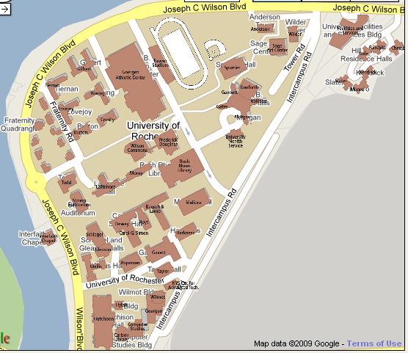
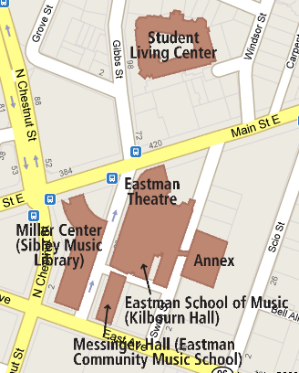
Campus Postering Map
Area 1 Living Quad, Gym, WC
Tiernan, Gilbert, Hoeing, Lovejoy, Burton, Crosby – bathrooms, doors, bulletin boards (Feed posters to RAs)
Todd Union
Wilson Commons and Douglass – table slips for Starbucks, Pit, and Flag Room, posters
Area 2 Library, Sue B, Towers, Hillcourt
Library, Gleason, ITS – tables and posters
Sue B poster hallways
Danforth and café table fliers and posters
Med Building posters
Sage posters
Towers, Hillcourt posters (Feed Posters to RAs)
Area 3 Academic Quad
Along hallways in tunnel system
Bulletin boards in upper levels of Meliora, Lattimore, Morey, B&L, Dewey
Hutchinson and Hoyt posters
Goergen table slips for Pura Vita and tables throughout study spaces on higher floors
Area 4 Eastman
Eastman Theater entrance posters
Living center posters
Sibley Music Library table fliers

Slide 2
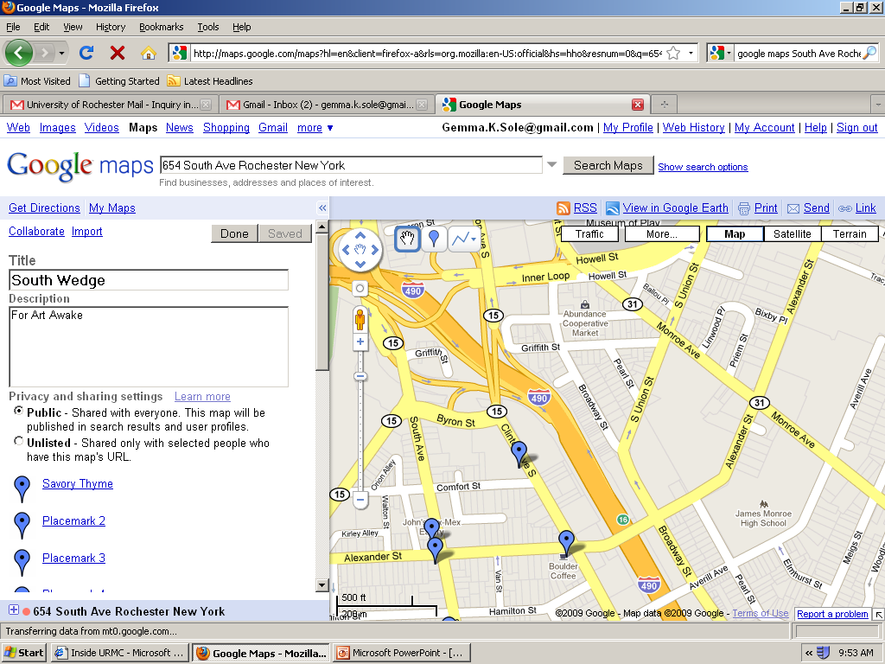
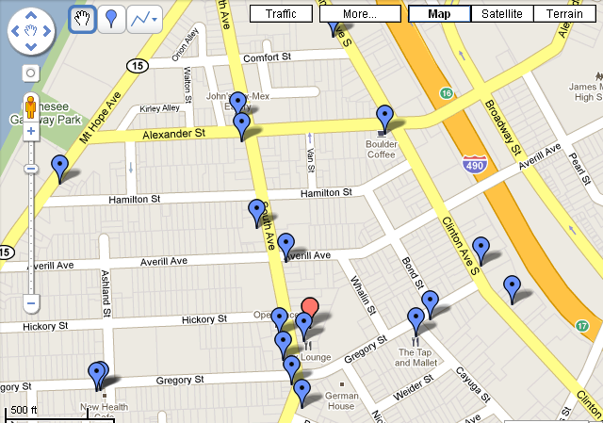
SOUTHWEDGE
A Savory Thyme
B John’s Tex Mex and Nathanielson’s
C The Colony
D Goodwill
E Boulder Coffee
F Music Store
G Cheesecake Store
H Thread and Thread Home
I Lux
J 2 Hair salons
K Tattoo Parlor
L Open Face
M Hedonist Chocolate
N Mis en Place
O Coffee Connection
P Boutique Second Hand
Q Wine Bar
R BBQ Place
S Hat and accessories store
T Incense store
(Whatever else is around there…)
U New Health Café
V Tru Yoga
W Pizza Place
X Equal Grounds
(include Vegan Bakery if open)
Ys Tap and Mallet, Tango Café and Genesee Credit Union
Zs Moped store and Marian’s Second Hand
AA Abundance Co-op Market and Bug Jar and New Health Cafe
AA
D
B
C
E
A
F
G
Zs
Ys
H-T
U -V
W-X

Slide 3
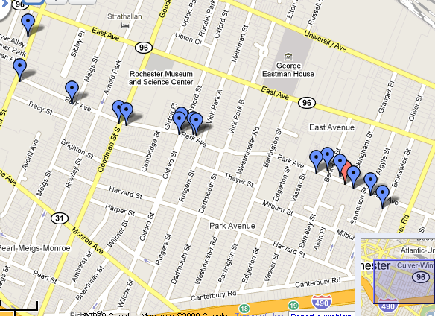
Park Ave
http://www.park-avenue.org/ has a list of current shops on Park for reference.
The easiest thing to do may be to start at one end and walk or drive down to the other, stopping at relevant stores.
Some possible drop-offs are listed below:
2Chic Boutique #155 Park Ave. (218-4384)
A Step Apart #235 (241-3110)
Baker Street #745 (241-3120)
dado Boutique #699 (271-7890) Email Us
The Jembetat Gallery #645 (442-8960)
Lakeshore Record Exchange #370 (244-8476)
Living Color Tattoo Studio #717 (271-2250)
MAE Beads #333 (242-5880)
Mystic Moon on Park #115 (461-3111)
One Hip Chic Optical #235 (461-2020)
Park Ave Knit Creations 40 Vassar St (943-4227)
Parkleigh #215 (244-4842)
Stever's Candies #623 (473-2098)
Thelma's #251 (256-2460)
Utter Clutter #121 (271-1130)
Wellness Within #703 (233-8894)
Wilson Farms Food Store #622 (442-0301)
Gallery r #775 Park Ave. (242-9470)
Camille’s #657
Chester Cab Pizza #707
CiBon Café #688
Hoagn’s Hideaway #197
Magnolia’s #366
Spin Café #739

Slide 4
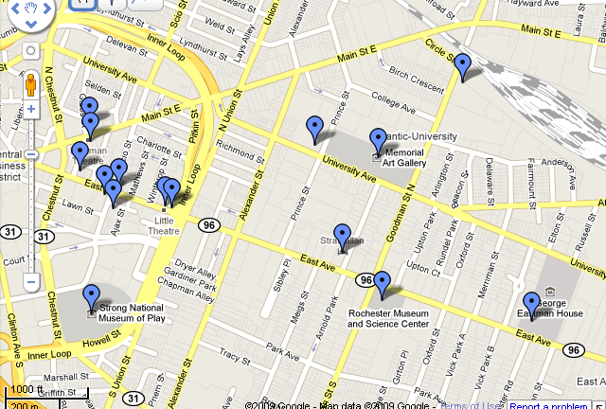
East Ave
A Eastman Theater
B Eastman Living Center
C Java’s
D RoCo
E Hotel behind Roco?
F Spot Coffee
G Little Theater
H Flower Shop
I Strathallen Hotel
J Rochester Museum and Science Center
K Strong Museum
L Strong National Museum
M MAG
N High school of the Arts
O Village Gate
Every poster board inside the village gate
  Oa California Rollin’
  Ob second hand shop
  Oc record shop
  Od entire second floor with corporate offices
  Oe Lento
Etc – any other relevant shops and restaurants
P George Eastman House
Q Artists lofts by Village Gate
R Good Luck

Slide 5
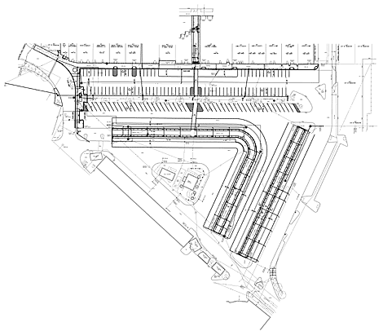
Public Market
A – C These are good places to stand to hand out fliers for the event.
D Java’s
E Boulder
F Cheese Shop
G Baked Goods
H Flyer telephone poles
I Put fliers on cars?
J New supermarket
K Market offices

Slide 6
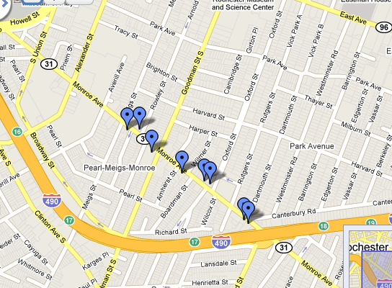
Monroe
A Genessee center for Arts and Education
B YMCA
C Lucky Lotus studioes
D Lumiere Photo
E Rick’s Recycled books
F G Inc. Designs
G Aaron’s Alley
H Erica’s Corner
I Krudco skate and surf shop
J Bead Designss
K Natural Oasis Market
L Shoe shop

Slide 7
Other
Artisan Works
Med Center
Geva Center
Sue B

